Slide 1
[7.5] Molarity

Slide 2
Molarity and Concentration
Molarity (also sometimes referred to as molar concentration): which is the number of moles in one liter of solution.
We calculate molarity by:
Molarity (M) = ______n(moles of solute)_________
V (total volume of solution in Liters, L)
Sometime “C” is used instead of M

Slide 3
Molarity and Concentration
Molarity (M) = ______n(moles of solute)_________
V (total volume of solution in Liters, L)
Note: When you see a chemical formula written in square brackets. Example: [H₂SO₄]
This means that it is the molarity (units mol/L)

Slide 4
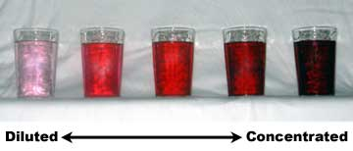
Concentration of Solutions
Dilute Solutions Small quantity of solute per unit volume of solution. |  | Concentrated Solutions Large quantity of solute per unit volume of solution.

Slide 5
Practice Problem #1
Find the molar concentration (molarity) of 60.0 mol of salt in a 500.0 mL solution.
60.0 mol
500.0 mL
1000mLl
1 L
[Salt] = x = 1.20 x 10² M

Slide 6
Practice Problem #1
Find the molar concentration (molarity) of 60.0 mol of salt in a 500.0 mL solution.
60.0 mol
500.0 mL
1000mLl
1 L
[Salt] = x = 1.20 x 10² M

Slide 7
Practice Problem #2
Find the molar concentration of 10.0 g of aluminum hydroxide dissolved in 6500 mL of solution.
10.0 g
6500 mL
1 mol Al(OH)₃ l
78.0 g
1000 mLl
1 L
[Al(OH)₃] = x x = 1.97 x 10²M

Slide 8
Practice Problem #2
Find the molar concentration of 10.0 g of aluminum hydroxide dissolved in 6500 mL of solution.
10.0 g
6500 mL
1 mol Al(OH)₃ l
78.0 g
1000 mLl
1 L
[Al(OH)₃] = x x = 1.97 x 10⁻²M

Slide 9
Practice Problem #3
Congratulations, you are hired as a chemist! Your first task is to calculate the mass of barium hydroxide you would need to make 50.0 L of a 5.0 mol/L solution. ☺
# of moles = $\frac{mass}{MOlar Mass}$
[Ba(OH)₂] = $\frac{mol}{volume}$
mass = moles × Molar Mass
= 2.5×10² mol × 171.3 $\frac{g}{mol}$
= 4.3×10⁴ g
mol = [Ba(OH)₂] × volume
= 5.0 mol/L × 50.0 L
= 2.5×10² mol

Slide 10
Practice Problem #3
Congratulations, you are hired as a chemist! Your first task is to calculate the mass of barium hydroxide you would need to make 50.0 L of a 5.0 mol/L solution. ☺
# of moles = $\frac{mass}{MOlar Mass}$
[Ba(OH)₂] = $\frac{mol}{volume}$
mass = moles × Molar Mass
= 2.5×10² mol × 171.3 $\frac{g}{mol}$
= 4.3×10⁴ g
mol = [Ba(OH)₂] × volume
= 5.0 mol/L × 50.0 L
= 2.5×10² mol

Slide 11
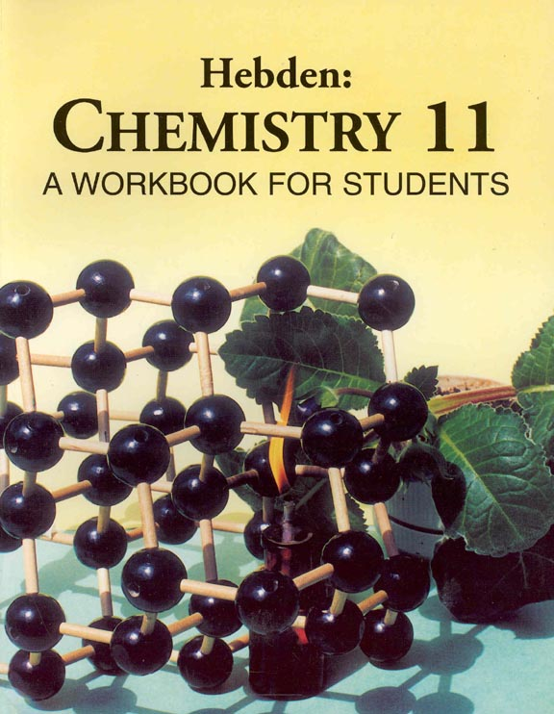
HOMEWORK
Textbook: Hebden
Page: 98
Questions: 59 A-C, 61 - 65

